Slide 1
Traffic Stop Data Analysis
Niyi Harrison

Slide 2
Research Question
Predicting incident outcomes of traffic stops based on driver attributes, location information and other incident meta data
Is DWB (Driving While Black) a real thing?
Outcome Variable: Police Intervention Disposition (Warning, Ticket or Arrested)

Slide 3
Hypothesis
I was expecting to find that being a black/brown male would increase your probability to receive a ticket or get arrested during a traffic stop

Slide 4
Where did you get the data
Subscribed to “Data is Plural”
Connecticut Data Collaborative
Traffic Stop Data by each police department in Connecticut from Oct 1, 2013 to Sep 30, 2015
Mostly Categorical
Driver Information
Reason for Stop
Result of Stop

Slide 5
Data Clean
Uniform formatting
Date time
Booleans
Spelling Errors
Removing questionable values
Driver ages below 15 and above 85
Creating Feature Variables
Racial Group = Race + Ethnicity
Pair Down Intervention Results to 3 Groups

Slide 6
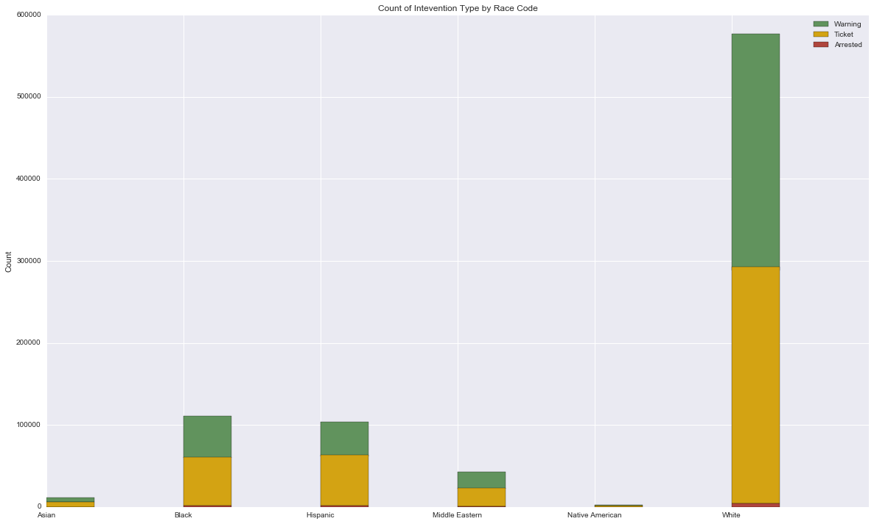
Data Exploration
Counts of Intervention Result by Race Groups

Slide 7
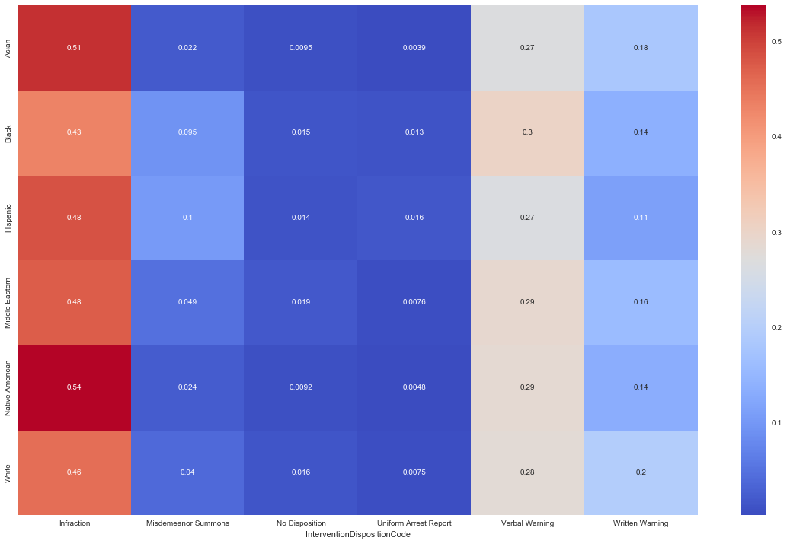
Data Exploration Cont.
Percentage of Intervention Results by Race Group

Slide 8
Results
Logistic Regression
Outcome Variable: Whether a stop will result in a ticket/arrest or without
Features: Race, Sex and Age
Accuracy: 54%
Coefficient Results: Black you will have a 12% increased chance of getting a ticket/arrested
Hispanic Drivers have a 44% increased chance
Men have a 13% increased chance of having a negative outcome

Slide 9
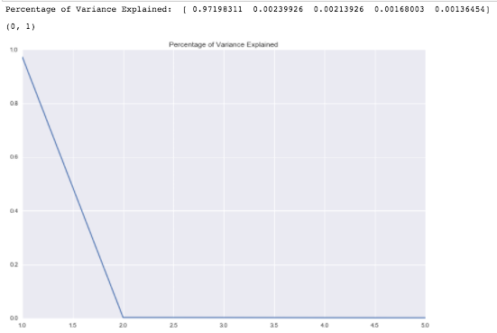
Results Cont.
Principal Component Analysis/Logistic Regression
Features: 16 Variables including Department, Intervention duration, Reason for stop, etc.

Slide 10
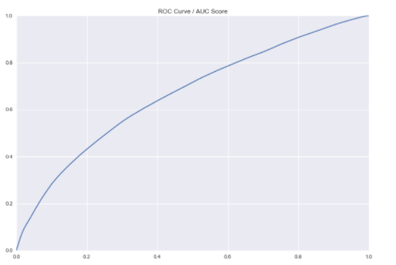
Results Cont.
Accuracy: 62%

Slide 11
Next Steps
Data from more states and cities
Additional feature variables such has town demographics
Random Forest Classifiers

